Slide 1


Crop Prediction System using Machine Learning Grp no:19CSP14
NITTE MEENAKSHI INSTITUTE OF TECHNOLOGY
(AN AUTONOMOUS INSTITUTION, AFFILIATED TO VISVESVARAYA TECHNOLOGICAL UNIVERSITY,
BELGAUM , APPROVED BY AICTE & GOVT.OF KARNATAKA)
Department of Computer Science and Engineering
(Accredited by NBA Tier-1)
Presentation By:
Pramod Sudi 1NT16CS077
Vijay S Y 1NT16CS131
Adarsh R 1NT16CS005
Deekshitha R 1NT16CS028
Guided By:
Dr. Nalini N
Dept. of CSE,NMIT

Slide 2
Table of contents
Problem Statement
Objectives
Literature Survey
Design
Level 0 Diagram
Dataflow diagram
Use case Diagram
Methodology
Completion progress
References

Slide 3
Problem statement
Farmers need not grow the same crop every year as the soil conditions change. So we build a system to scientifically predict the best crop based on soil conditions and assist him on the same.

Slide 4
Objectives
To predict the best crop based on the conditions of the soil.
To avoid the risks of growing a wrong crop unscientifically.
To collect a scientifically predicted crop of each and every farmer and estimate the yield beforehand.
To provide an interface that successfully converts the data related to a crop into speech and present it to the user like a video assistant.

Slide 5
Literature survey
Dataset:
From Agricultural department through soil health card(SHC)
SHC will contain the status of farmer’s soil with respect to 12 parameters and advice him/her on the dosage of fertilizers.
Dataset maintained by the system
Generate this dataset by analyzing the various studies that has taken place for the conditions needed for each crop to grow optimally.
Dataset related to each crop
For each crop, we store a certain set of data related to each describing the various techniques through which that crop can be optimized.
Crops to be classified:
A certain set of crops that possibly have the conditions in terms of range are to be used.

Slide 6
A research paper was published by Prof. D.S. Zingade, Omkar Buchade, Nilesh Mehta, Shubham Ghodekar and Chandan Mehta on “Crop Prediction System using Machine Learning” using data analytics and machine learning at International Journal of Advance Engineering and Research Development.
Monali Paul, Santosh K. Vishwakarma, Ashok Verma published a research paper. In order to predict the yielding of the crops, the crops are analyzed and based on analysis they are categorized.
S.Nagini, Dr. T. V. RajiniKanth, B.V.Kiranmayee. This paper theorizes an Explorative data analysis and discusses about designing of various predictive model.
Various agricultural papers that contained details of each crop and its requirements.

Slide 7
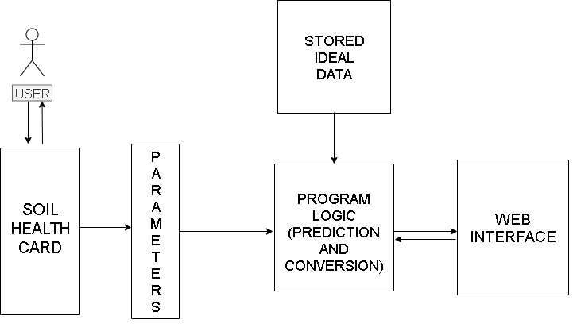
Design
Give parameters in soil card as input.
Pass those parameters to the machine learning model.
Use model to predict the crop using training dataset.
Display the predicted crop on the web interface.
Derive the details of crop predicted and present them to the user.
Fig 3: Level 0 for proposed system

Slide 8
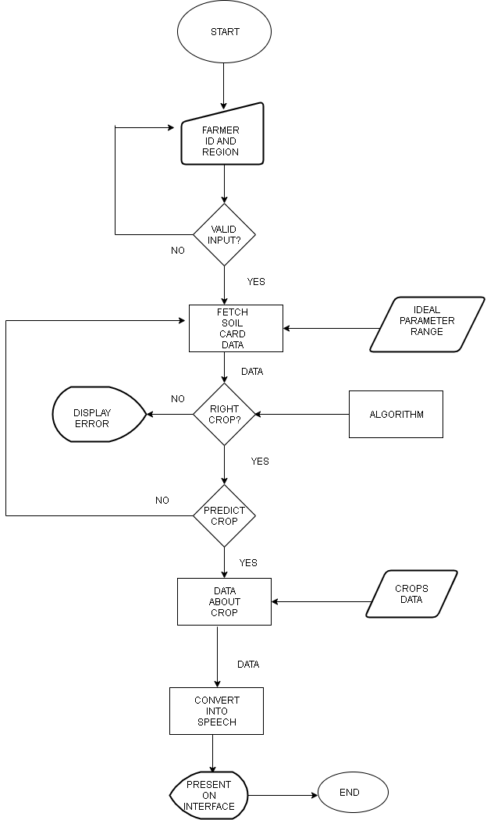
Dataflow diagram

Slide 9
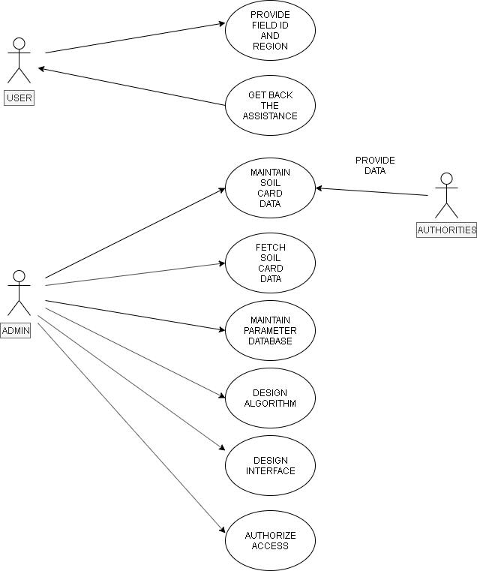
Use Case Diagram
Fig 5: Use Case Diagram

Slide 10
METHODOLOGY
A methodology is a collection of methods, practices, processes, techniques, procedures, and rules. In project management, methodologies are specific, strict, and usually contain a series of steps and activities for each phase of the project's life cycle. We have implemented an iterative development cycle for our project.
The modules involved in developing the prototype are:
Data collection
Developing Algorithm
Prediction Model
Extracting the assistance related to the predicted output
Develop interface for displaying the results

Slide 11
Tools used
Visual Studio Code for development.
Flask micro framework
Jupyter notebook for model development and prediction.
Other related packages for development.

Slide 12
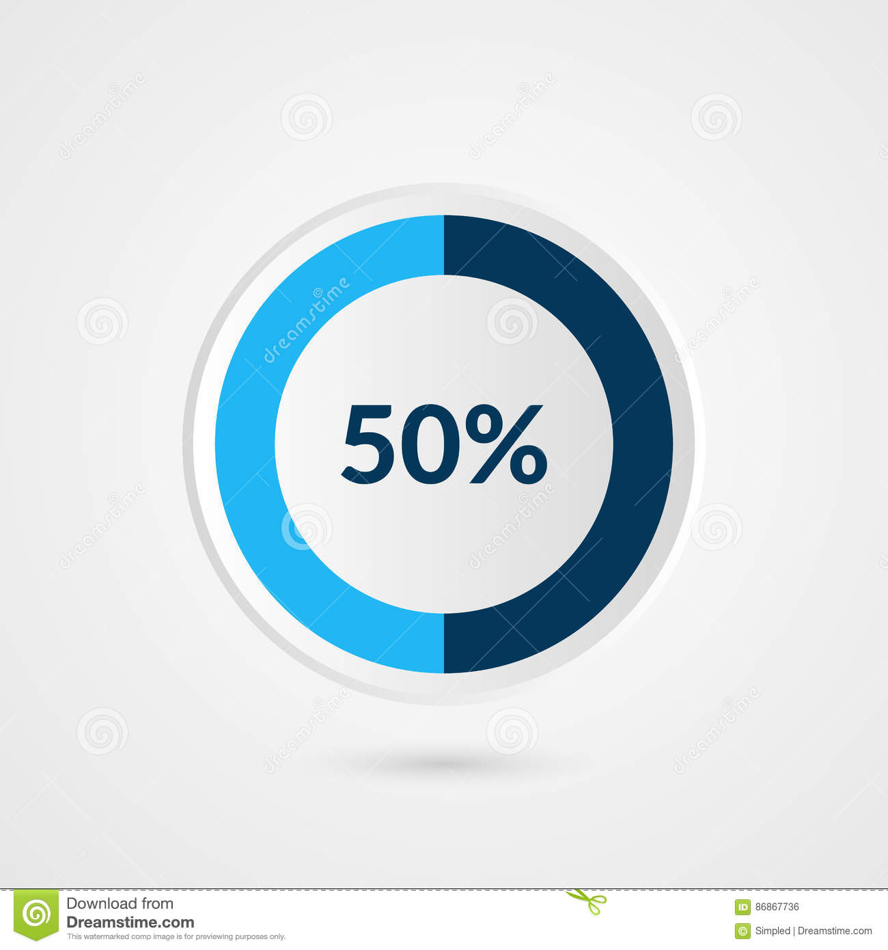
PROGRESS
50% of the project is done as one of the two main modules are done:
PREDICTION – completed
Next module:
CONVERSION of text to speech

Slide 13
REFERENCES
Expert system, “machine learning”
Available: https://expertsystem.Com/machine-learning-definition/
ALL YOU NEED TO KNOW ABOUT MACHINE LEARNING - APPLICATIONS, HOW IT WORKS, AND WHO USES IT
Available : https://www.Outsource2india.Com/software/articles/machine-learning-applications-how-it-works-who-uses-it.Asp
Flask.com/documentation

